Slide 1
Chapter 15

Slide 2
Objectives

Slide 3
Objectives

Slide 4
A URL with search parameters

Slide 5
Methods of the location object

Slide 6
How to load a new page and overwrite the current history page

Slide 7
One property of the history object

Slide 8
How to use the back() method

Slide 9
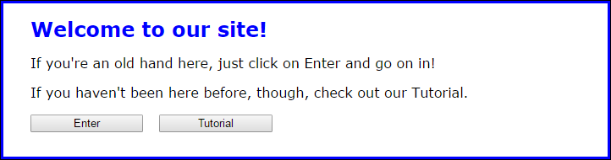
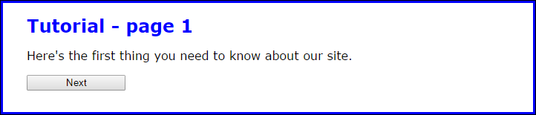
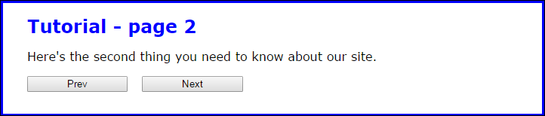
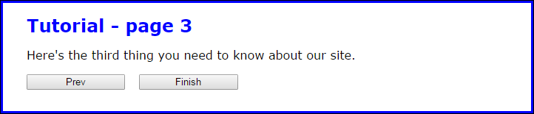
The four pages of the Tutorial application

Slide 10
The HTML in the main element of the index.html file

Slide 11
The HTML in the main element of the tutorial files

Slide 12
The JavaScript in the document.ready event of each file

Slide 13
The JavaScript (continued)

Slide 14
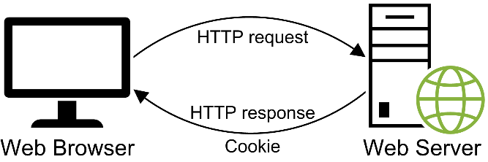
A browser usually gets a cookie as part of an HTTP response

Slide 15
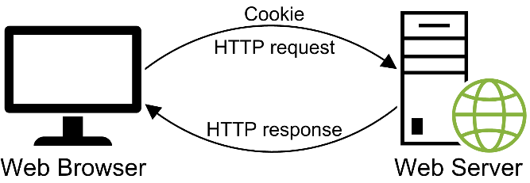
A browser sends the cookie back to the server with each HTTP request

Slide 16
Attributes of a cookie

Slide 17
Terms

Slide 18
Two functions for working with cookies

Slide 19
How to create a session cookie

Slide 20
How to create a persistent cookie

Slide 21
How to add multiple cookies to the document.cookie object

Slide 22
A setCookie() function that creates a session or persistent cookie

Slide 23
Three cookies in the document.cookie object

Slide 24
A getCookieByName() function (continued)

Slide 25
The cookie to delete

Slide 26
A deleteCookie()function that deletes a cookie

Slide 27
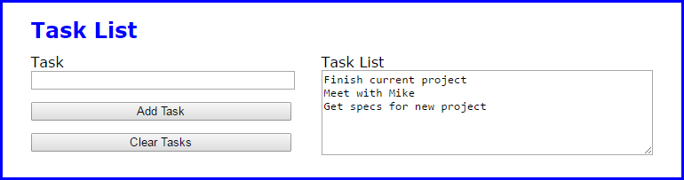
The Task List application in the browser

Slide 28
The HTML for the Task List application

Slide 29
The HTML (continued)

Slide 30
The JavaScript for the Task List application

Slide 31
The JavaScript (continued)

Slide 32
The JavaScript (continued)

Slide 33
The syntax for working with local storage

Slide 34
The syntax for working with session storage

Slide 35
The shortcut syntax for getting or saving an item

Slide 36
JavaScript that uses local and session storage for hit counters

Slide 37
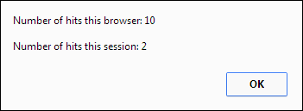
A message box that shows the current value of both hits fields

Slide 38
Terms

Slide 39
The Task List application with web storage

Slide 40
The JavaScript for the Task List application

Slide 41
The JavaScript (continued)

Slide 42
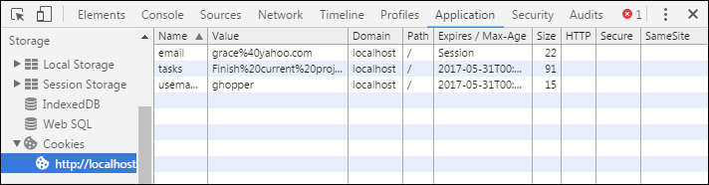
The cookies for an application in the Application panel

Slide 43
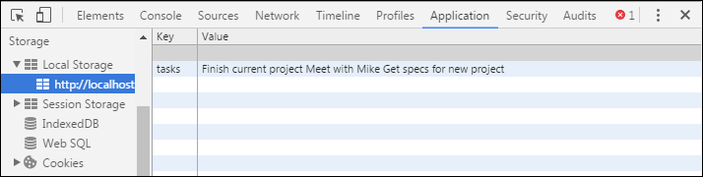
The local storage items for an application in the Application panel

Slide 44
How to use the Application panel in Chrome to work with stored items

Slide 45
How to delete a cookie or web storage item

Slide 46
How to edit a web storage item

Slide 47
Extra 15-1 Navigate between pages and save data in a cookie

Slide 48
Extra 15-2 Navigate between pages and save data in session storage

Slide 49
Short 15-1 View the query string of a URL

